Slide 1
From Noise to Narrative
A Visualization Tool for DDoS Events Across PEST Dimensions
Jesse van Dijk
Business Information Technology
s2920174
j.vandijk-9@student.utwente.nl

Slide 2
Introduction
Current affairs: Recent attacks on Israel, European Parliament (2023)
Situation: DDoS attacks are relevant threats, and are actively being reported on
Complicatie: it is hard to gain insight into the impact of these dimensions
Question: How do we measure and visualize different dimensions of impact of a DDoS event by clustering article-level news data?

Slide 3
Research Questions
RQ1: To what extent does news coverage of a DDoS event reflect its PEST-dimension impact?
RQ2: How effectively can event-level groupings of DDoS events be constructed from article-level news data using semantic embedding and clustering?
RQ3: How do we create a measurement tool to visualize the impact of an event based on the annotated dataset?

Slide 4
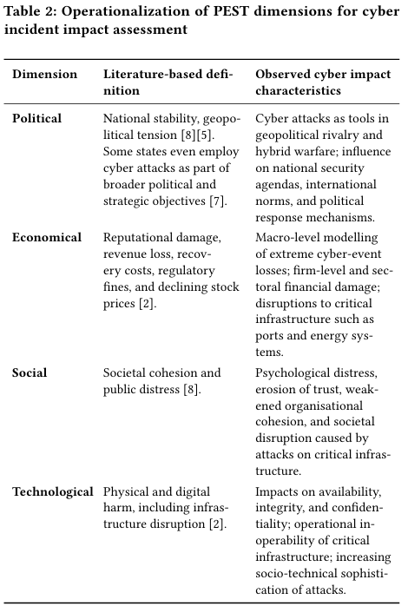
PEST
Political
Economical
Social
Technological

Slide 5
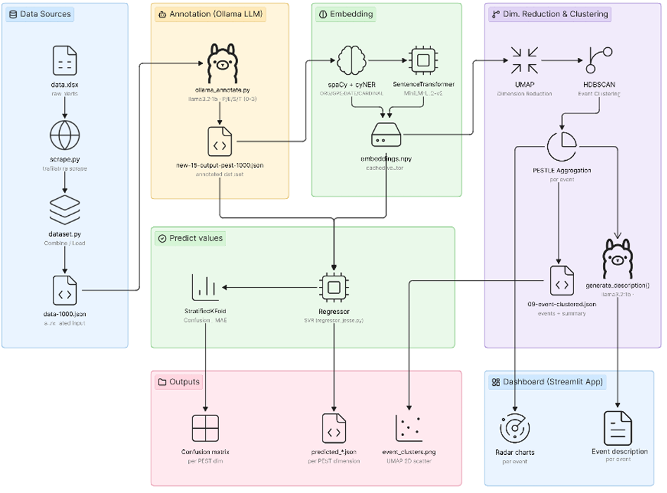
Architecture

Slide 6
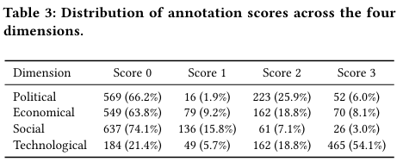
Data + annotation
Complete database of 235913 articles
Between 20-8-2015 and 10-5-2023
1000 selected, 860 DDoS relevant

Slide 7
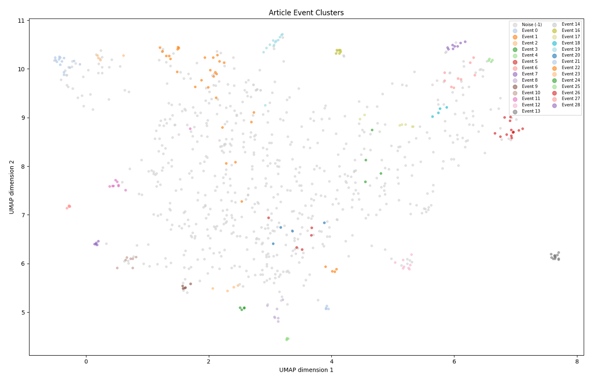
Clustering
UMAP
HDBSCAN
Min_cluster_size
Min_samples
Max_cluster_size

Slide 8
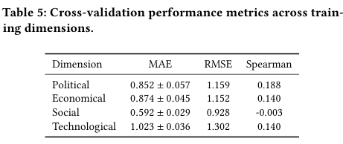
Regressor
Goal: Test if PEST impact is learnable
SVR with nested cross-validation
Label noise sets upper performance bound

Slide 9
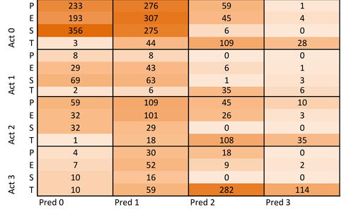
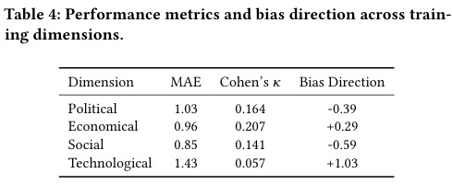
Results 1

Slide 10
Results 2
28 events, 860 articles, 75.8% noise

Slide 11
Conclusion 1
LLM annotation is not a reliable substitute for human judgment (κ = 0.057–0.207)
SVR cannot predict PEST scores from embeddings alone (Spearman ≈ 0–0.19)
Label noise from the LLM likely explains poor regression performance
Κ < 0.2 = poor

Slide 12
Conclusion 2
‘Correctly’ identify 28 distinct events from 860 articles
Manual validation through each event, subset discussed in paper
Entity-enriched embeddings + HDBSCAN successfully clusters related articles
75.8% noise is high, but is a deliberate tradeoff favoring precision over recall

Slide 13
Conclusion 3
Artifact demonstrates automated event-level impact analysis is feasible without manual labelling
Pipeline combines LLM annotation → semantic embedding → clustering → radar chart visualization
Reliability bounded by quality of LLM annotations
Published openly on GitHub

Slide 14
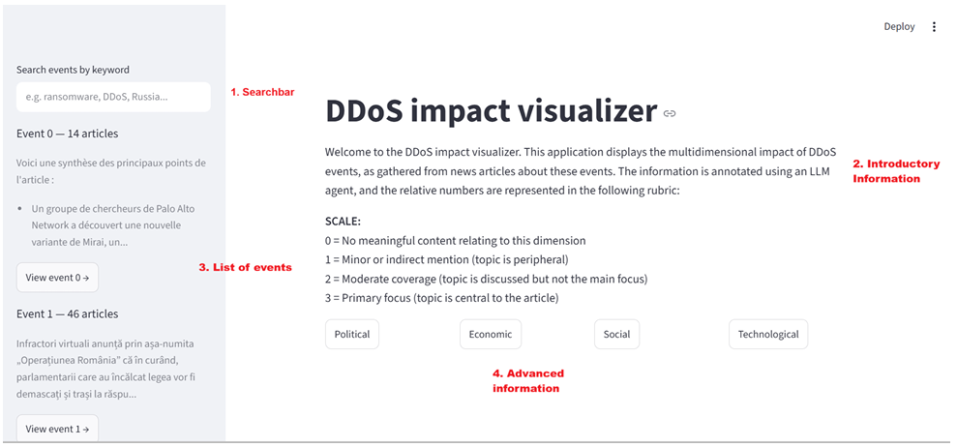
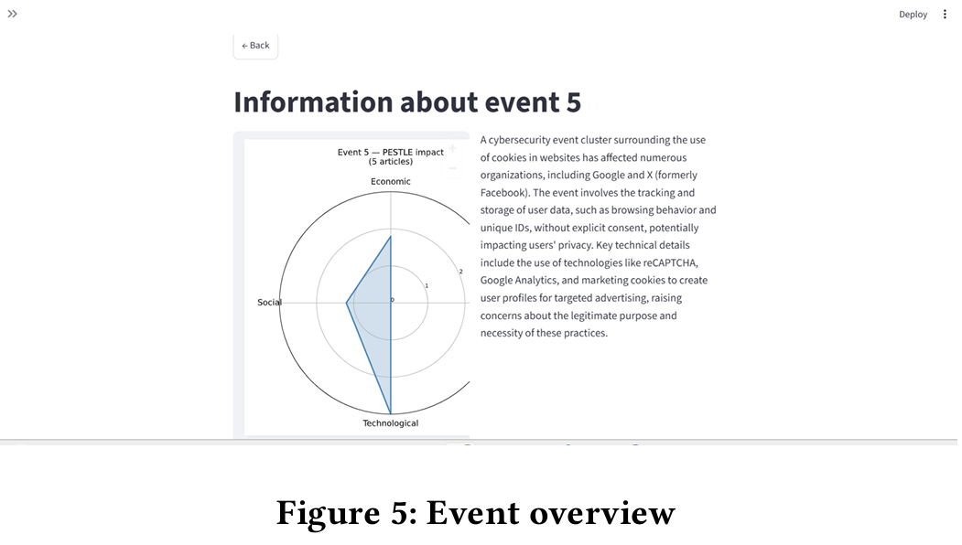
Artifact showcase

Slide 15
Limitations + future work
Regression model comparison
Llama 3.2 quality vs. larger models
Increase entity enrichment
Single out attack news instead of all DDoS events

